Slide 1

BENACERRAF AND FIELD'S ARGUMENTS AGAINST MATHEMATICAL PLATONISM
Mathematical Platonism
Philosophical theory about the metaphysics of mathematics. Platonism states that mathematical objects are mind independent and unaffected by space and time. We are thought to discover mathematical truths as opposed to inventing them.

Slide 2
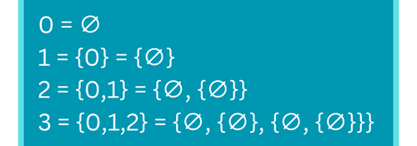
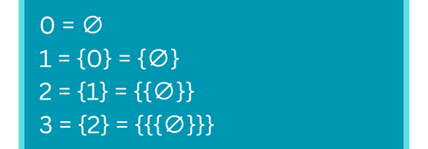
The Identification Problem:
In the problem of identification, Benacerraf demonstrates there are various ways of representing natural numbers with sets, for example the Zermelo method and von Neumann. Both of these offer equally adequate constructions, however there is no known method for selecting the correct one, suggesting numbers aren't defined by a specific set.
von Neumann construction:
Zermelo construction:
Paul Benacerraf argued against mathematical Platonism in his works "What Numbers Could Not Be" and "Mathematical Truth", and in favour of structuralism - the view that mathematical objects do not hold intrinsic value, but are defined by their relationships within an abstract structure.
Benacerraf therefore concludes that numbers cannot be unique abstract objects, instead we should view them as positions within the infinite progression.

Slide 3
The Epistemological Objection
Benacerraf's Epistemological Objection claims that there must be a causal connection between the knowledge and its knower.
However there is no direct or indirect link between abstract mathematical objects and the human mind, hence, if Platonism is assumed to be true, we do not have reliable mathematical knowledge.
Some may reject the epistemological problem by denying the causal theory of knowledge, one may argue that the human mind can percieve these abstract mathematical objects with intuition, as proposed by Gödel.

Slide 4
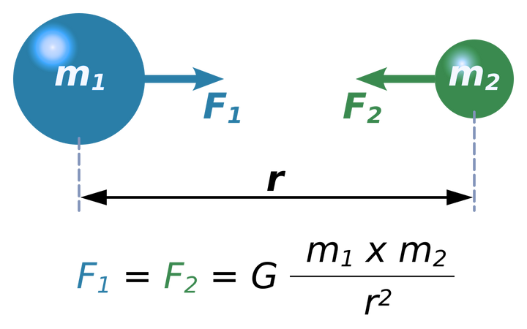
Field's Nominalism
Hartry Field presented the reliability challenge in his work "Science Without Numbers":
Supposing abstract mathematical objects exist, they are unable to influence our minds resulting in our mathematical knowledge being independent of them. Therefore, the strong correlation between our beliefs and mathematical facts would be a result of pure coincidence.
Newton's law of universal gravitation:
Field presents nominalism as the solution, a theory asserting that only concrete, physical objects exist and the existence of abstract mathematical objects is not indispensable to science.
Field attempts to demonstrate this by reformulating Newton's law of universal gravitation, replacing the use of numbers and functions with relationships between physical entities.
He consequently concluded that mathematics is conservative - it is not a source of knowledge about the physical world and is not required for developing new scientific theories, however its efficiency is evident, therefore it remains a highly useful tool.

